Slide 1

Project
Presentation
Adventure Works
Sales Performance Analysis
- By Komal Surwade

Slide 2

AGENDA
Project Introduction & Objectives
Dataset Overview
Excel Analysis
  Data Model
  Sales Performance Dashboard
Tableau Analysis
  Sales Analysis
  Profit Analysis
SQL Analysis
  Key Business Queries
Power BI Analysis
  Data Model
  Interactive Dashboard
Key Insights & Conclusion

Slide 3
Introduction & Objectives
Introduction
The project focuses on analyzing Adventure Works sales data to understand overall business performance.
The analysis combines sales transactions with customer, product, date and sales territory information.
Multiple analytical tools were used to transform raw transactional data into meaningful business insights.
The project follows an end-to-end analytics approach from data preparation to visualization and reporting.
Objectives
Analyze overall Sales, Production Cost and Profit.
Identify top-performing products and customers.
Analyze sales performance across time periods and regions.
Calculate important business metrics such as Total Sales, Total Profit and Profit Margin.
Create interactive dashboards for business performance monitoring.
Use SQL queries to extract and aggregate data required for analysis.

Slide 4
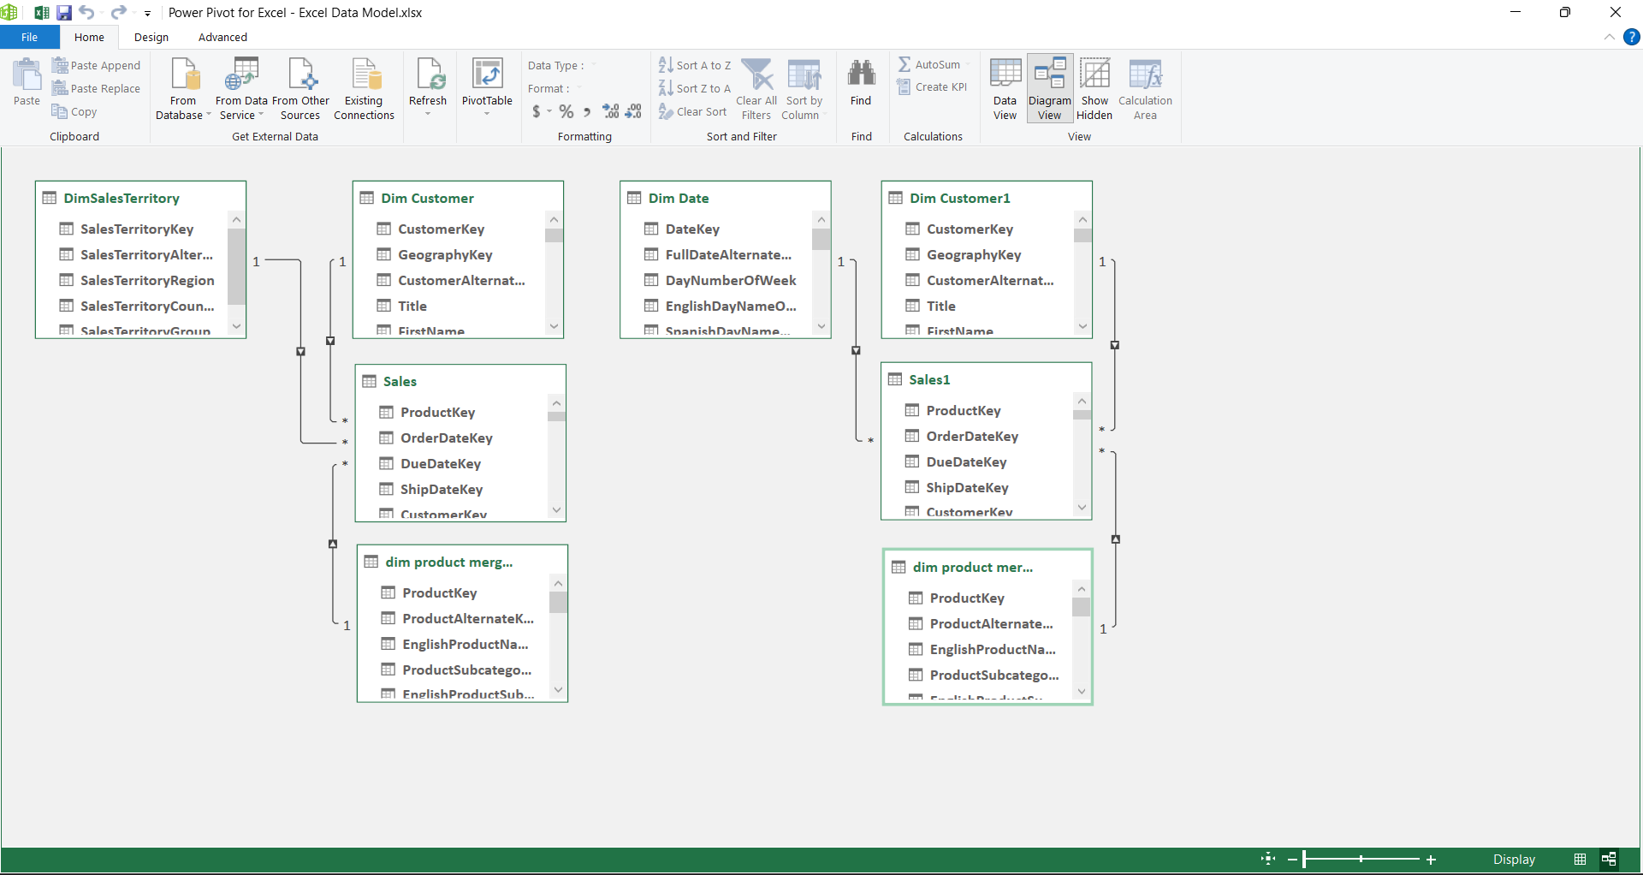
Excel Data Model
The data model provided a structured foundation for creating
PivotTables, charts, KPIs and the final Excel dashboard.

Slide 5
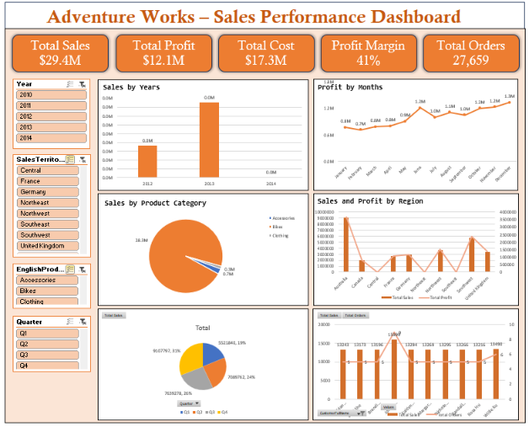
Excel Dashboard
The Excel dashboard provides an overall view of sales and profitability
performance using calculated measures, PivotTables and visualizations.

Slide 6
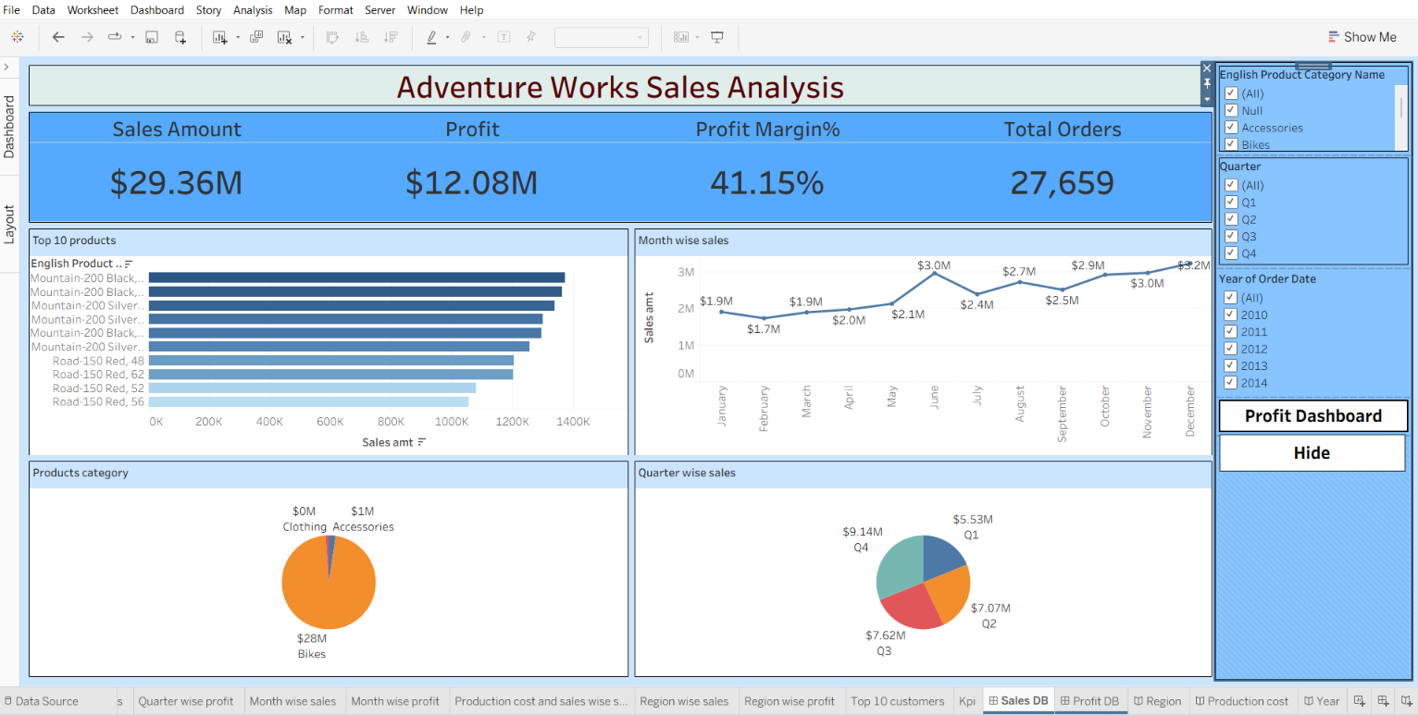
Tableau – Sales Analysis
The Tableau dashboard provides an interactive view of sales performance and
helps identify trends and high-performing business segments.

Slide 7
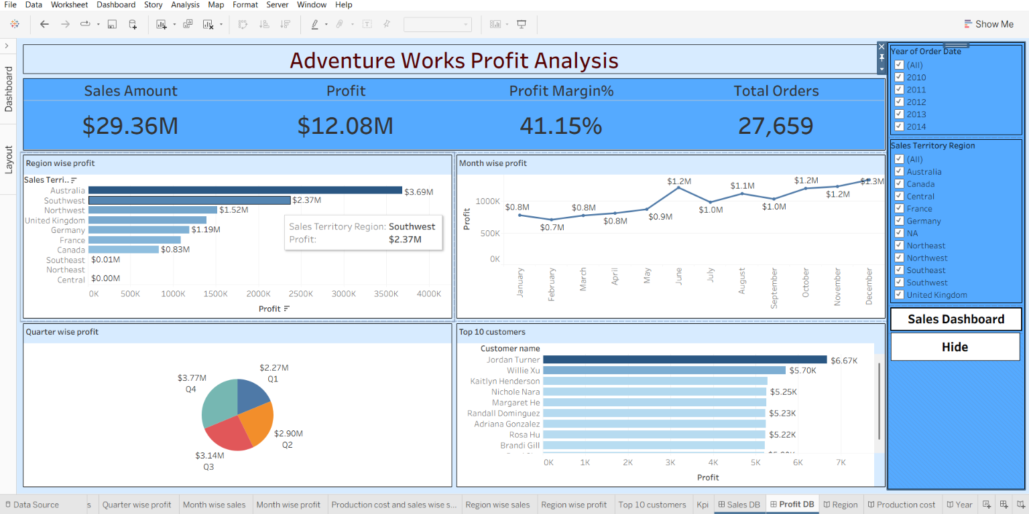
Tableau – PROFIT Analysis
The Tableau Profit Dashboard focuses on understanding profitability rather
than sales volume alone.

Slide 8
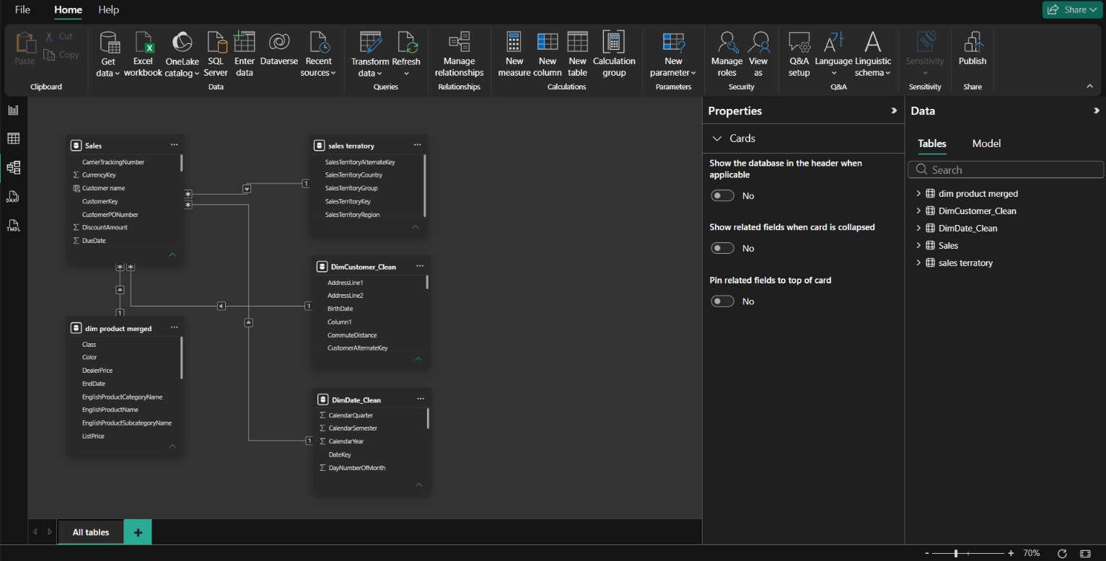
Power BI Data Model
The Power BI data model enables the same sales data to be analyzed dynamically
across products, customers, dates and regions.

Slide 9
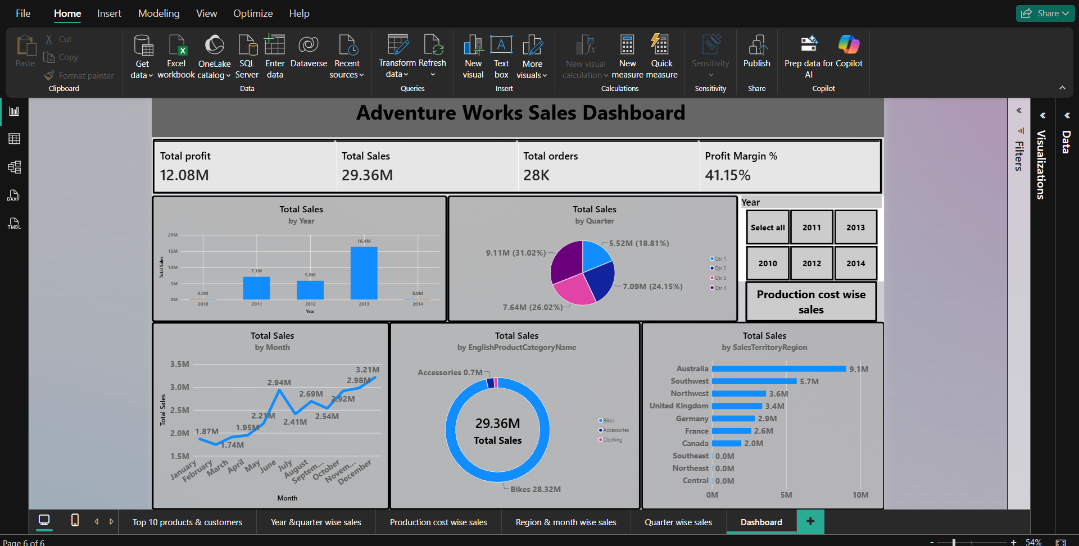
Power BI Dashboard
The Power BI data model enables the same sales data to be analyzed dynamically
across products, customers, dates and regions.

Slide 10
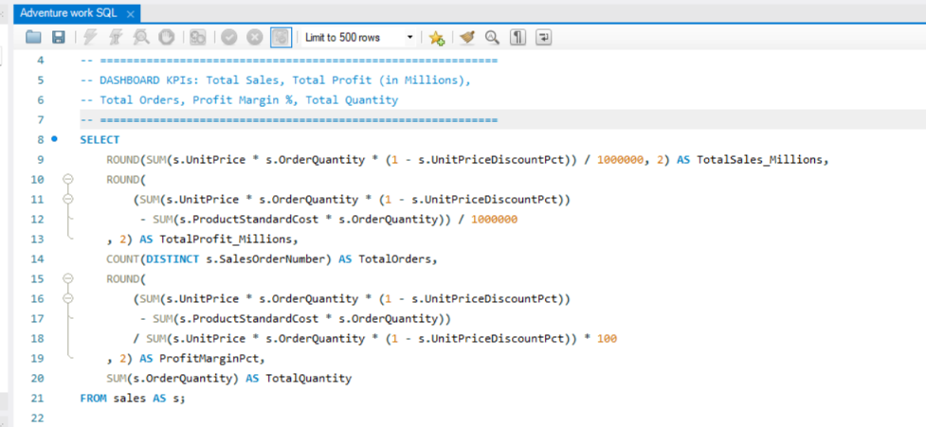
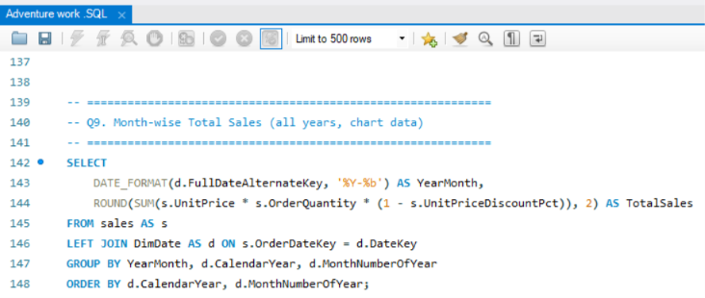
SQL Queries
SQL was used to transform transactional data into aggregated datasets and
business metrics that can support dashboard reporting.

Slide 11
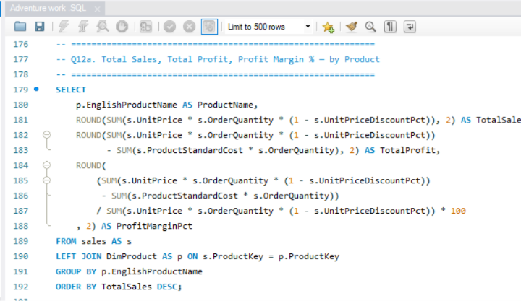
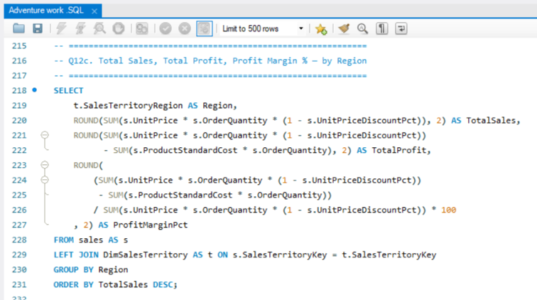
SQL Queries
SQL was used to transform transactional data into aggregated datasets and
business metrics that can support dashboard reporting.

Slide 12
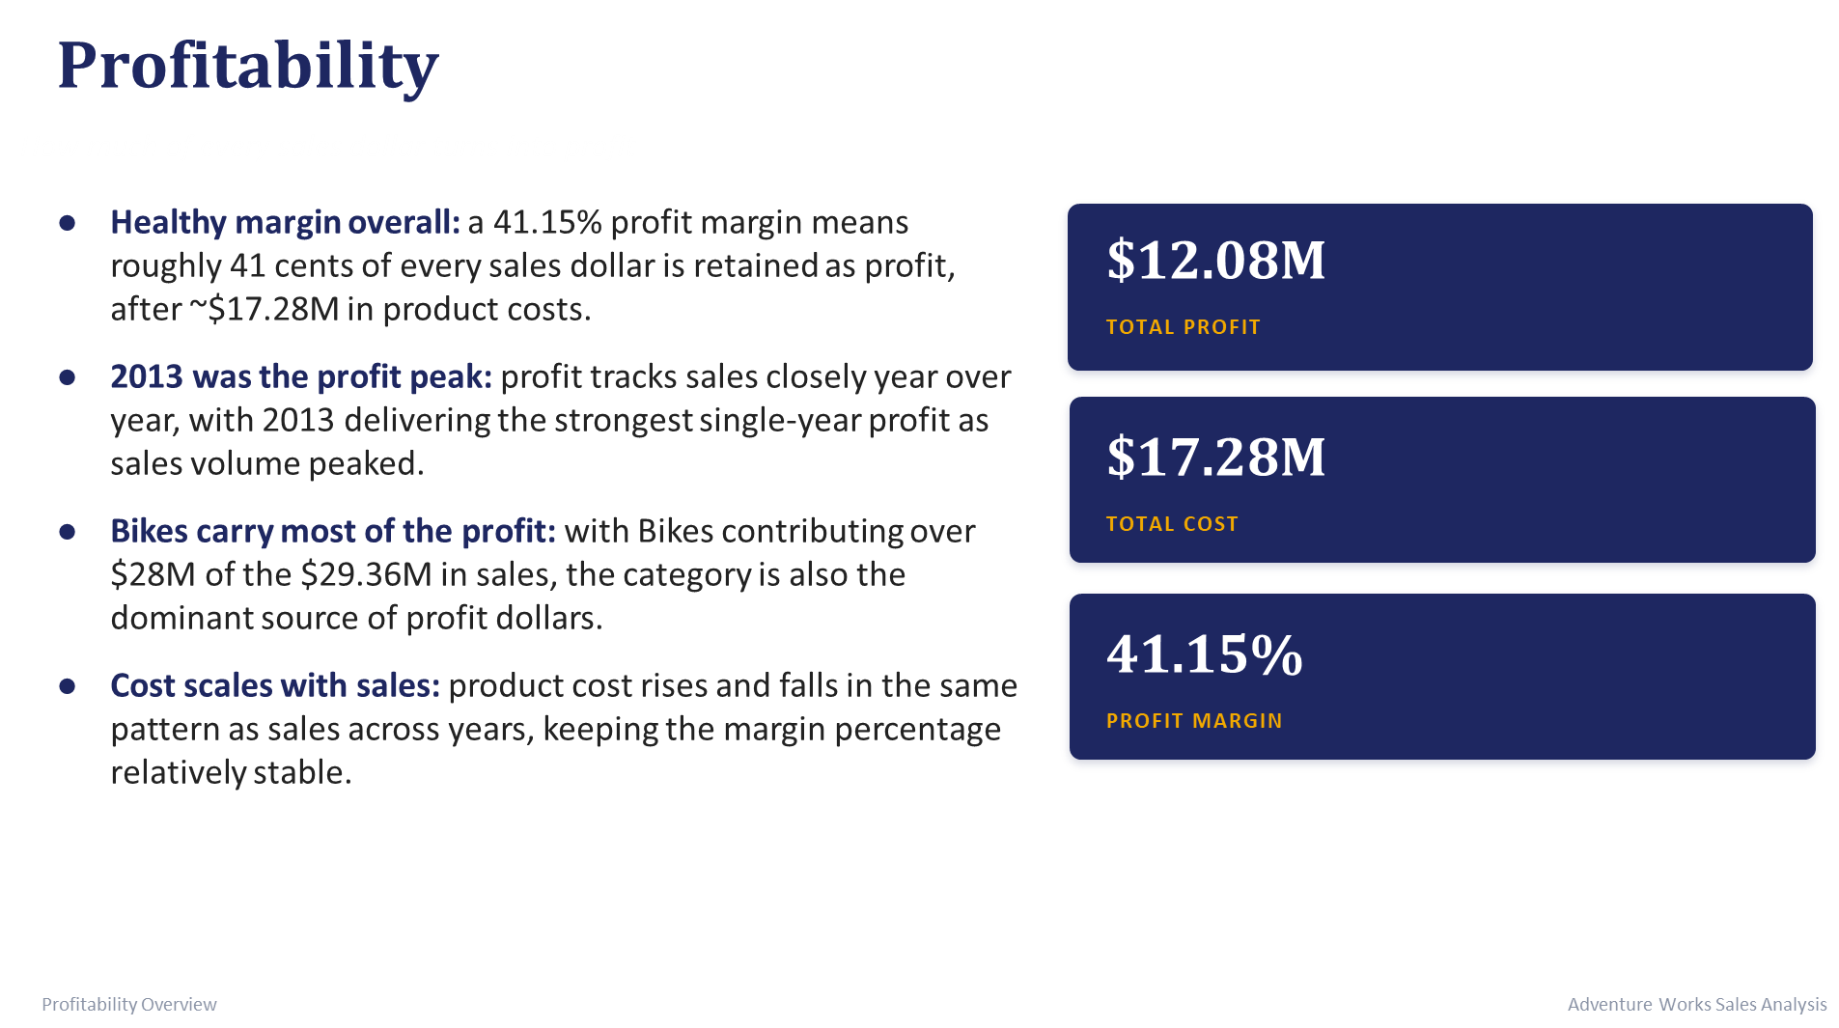
Profitability overview
Out of every sales dollar, Adventure Works keeps about 41 cents as profit.

Slide 13
Key Insights
Overall business performance can be evaluated using Sales, Profit and Profit Margin.
Product-level analysis helps identify top-performing products.
Time-based analysis highlights sales trends and performance patterns.
Regional analysis helps identify strong and weak sales territories.
Comparing Sales with Production Cost provides better understanding of profitability.
Combining Excel, Tableau, Power BI and SQL and provides an
end-to-end analytical workflow.

Slide 14
Conclusion
The Adventure Works project demonstrates how raw transactional data can be transformed into meaningful business insights using data preparation, data modeling, SQL analysis and interactive visualization tools.

Slide 15


